Slide 1




Hydrogen Storage Technology
Application to RES
Fabian Moisl
Jiří Smetana

Slide 2

Content
Introduction
Production of Hydrogen
Application of Hydrogen
Hybrid Power Plant Prenzlau
RH2 WKA
Conclusion

Slide 3

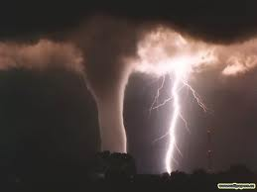

Introduction
EU: 20% RES by 2020
USA: 80% “clean energy sources“ by 2035
Problems of RES
  Land requirement
  Wildlife endangerment
  Forces beyond human control

Slide 4
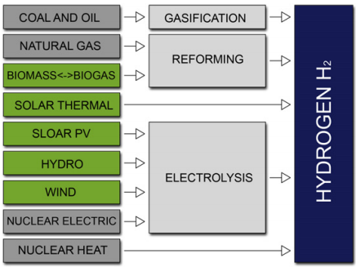
Production of Hydrogen

Slide 5
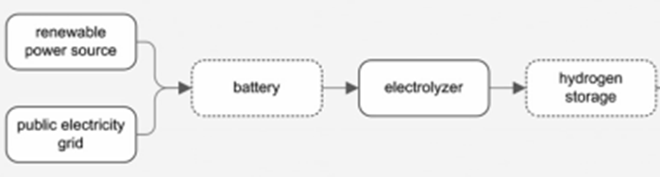
Production of Hydrogen
4% by electrolysis of water
  High energy consumption
Power-to-gas plants

Slide 6
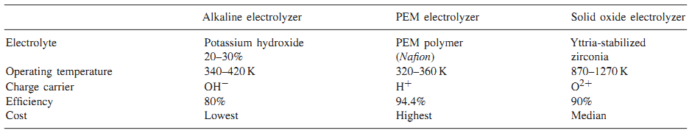
Production of Hydrogen
Electrolyzers:
Alkaline electrolyzer is most wide-spread
The importance of PEM (proton exchange membrane) is rising

Slide 7
Application of Hydrogen

Slide 8
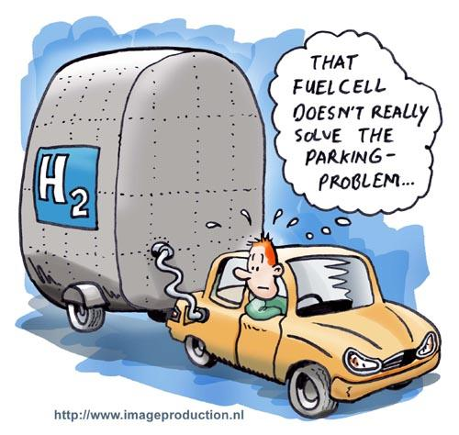
Generation of Electrical Energy Via
Fuel Cells
  Alkaline FC (AFC)
    60° - 90°C, efficiency 60% < 20 kW
  Phosphoric acid FC (PAFC)
    150° - 220°C, efficiency 40% - 50%
    < 200 kW
  Proton exchange membrane FC (PEMFC)
    60°C – 100°C, efficiency 40% - 50%,
    <250 kW

Slide 9
Installed Capacity of FC

Slide 10
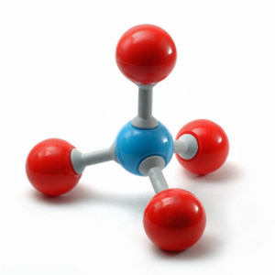
Public gas distribution system as hydrogen storage
Feed in pure hydrogen > to what amount?
Use hydrogen to produce synthesized methane (Sabatier-process)
CO₂ + 4H₂ è CH₄ + 2H₂O

Slide 11
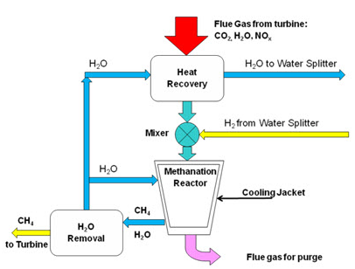
Sabatier-process

Slide 12
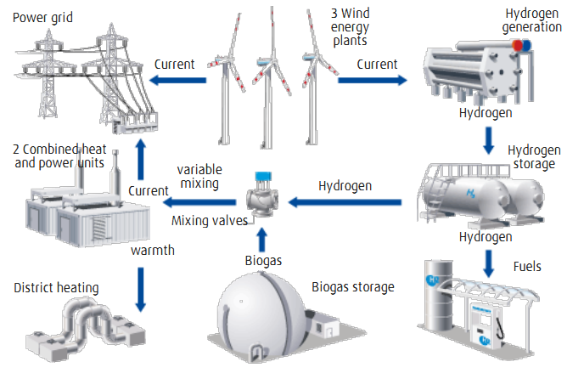
Hybrid Power Plant Prenzlau

Slide 13
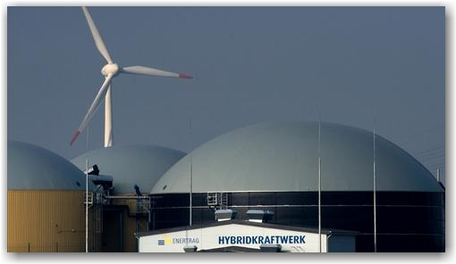
Hybrid Power Plant Prenzlau
6000 kW
No fuel cells, no battery
Alkaline electrolyzer (85% efficiency)
Compressed hydrogen gas storage
21 Million euro investment
1MW for 3.5 Million euro vs. 1 – 1.5 Million euro (gas, coal)

Slide 14
RH2 WKA
RH2 WKA

Slide 15
Wind energy plant
28 Wind turbines
  15 x E-126 /7,5 MW 13 x E-82 /2,3 MW (Enercon)
Total performance of 140 MW
Energy for 125.000 households = 15% MBV

Slide 16
Hydrogen production retransformation into electricity
pressurized alkaline electrolyzer 1 MW
210 m³/h hydrogen at 310 bar
2 cogeneration units
overall performance of 600 kWel
pure hydrogen is fired > no CO2 emissions

Slide 17
Costs and CO2 savings
Overall costs 220 million Euros (estimated)
  1,6 mio. €/MW
Government-sponsored with 4,5 million Euros
CO2 savings: ca. 250,000 tons per year

Slide 18
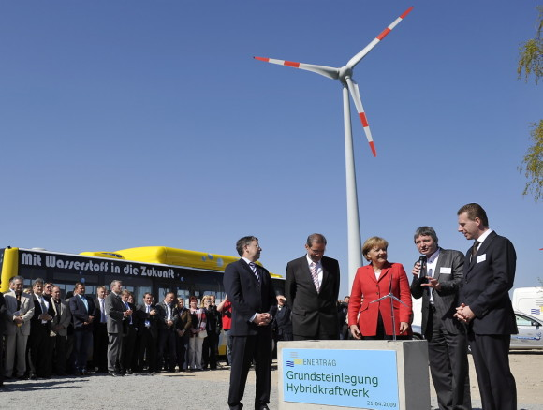
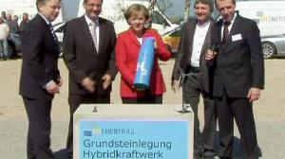
Conclusion
Analogous process for solar power plants
Great potential for the future
Too costly at the moment

Slide 19
References
Arnulf Grubler et al.: “Chapter 1: Energy Primer” in Global Energy Assessment: Toward a Sustainable Future, IIASA (2012), 108
Yoram Krozer: “Cost and benefit of renewable energy in the European Union“ in Renewable Energy 50 (2013)
Bettina B. F. Wittneben: “The impact of the Fukushima nuclear accident on European energy policy” in Environmental Science & Policy 15 (2012)
Hooi Hooi Lean, Russel Smith: “Are fluctuations in US production or renewable energy permanent or transitory?“ in Applied Energy 101 (2013)
http://www.ucsusa.org/clean_energy/our-energy-choices/renewable-energy/environmental-impacts-of.html
Olga Bičáková, Pavel Straka: “Production of hydrogen from renewable resources and its effectiveness” in International Journal of Hydrogen Energy 27 (2012)
Gerda Gahleitner: "Hydrogen from renewable electricity" in International Journal of Hydrogen Energy 38 (2013)
Meng Ni et al.: "Potential of renewable hydrogen production for energy supply in Hong Kong" in International Journal of Hydrogen Energy 31 (2006)
http://www.dvgw-innovation.de/fileadmin/dvgw/angebote/forschung/innovation/pdf/powertogas2011gwf.pdf
ENERTRAG.com
Hydrogen-Hybrid Power Station in Prenzlau is starting up operations , fuelcellsworks.com/news/2011/11/04/hydrogen-hybrid-power-station-in-prenzlau-is-starting-up-operations/
Green New Deal: Hybridkraftwerk Prenzlau - Hybrid power plant Prenzlau, greennewdeal.eu/?id=308&L=0
Fuel Cells Bulletin, Volume 2012, Issue 5, May 2012, Page 14, Wind-hydrogen used for first time at vehicle fuelling station in Germany
Sonal Patel, European firms complete Wind-to-Hydrogen-Power Plant, 1st Feb, www.powermag.com/renewables/wind/European-Firms-Complete-Wind-to-Hydrogen-Power-Plant_4317.html
http://www.rh2-wka.de/projekt/wind-wasserstoff-system.html?114,43
http://www.ostsee-zeitung.de/nachrichten/mv/index_artikel_komplett.phtml?SID=340648bdbab27dad0318916a38dc464c&param=news&id=3346892

Slide 20
