Slide 1
Independence of the Energy System in Austia and the Czech Republic
Czech – Austrian Winter and Summer School
Jitka Knapová
Stefan Nabernegg

Slide 2
Content
Introduction
Current Situation
Ecological Aspects
Economical Aspects
Suggestions
Conclusion

Slide 3
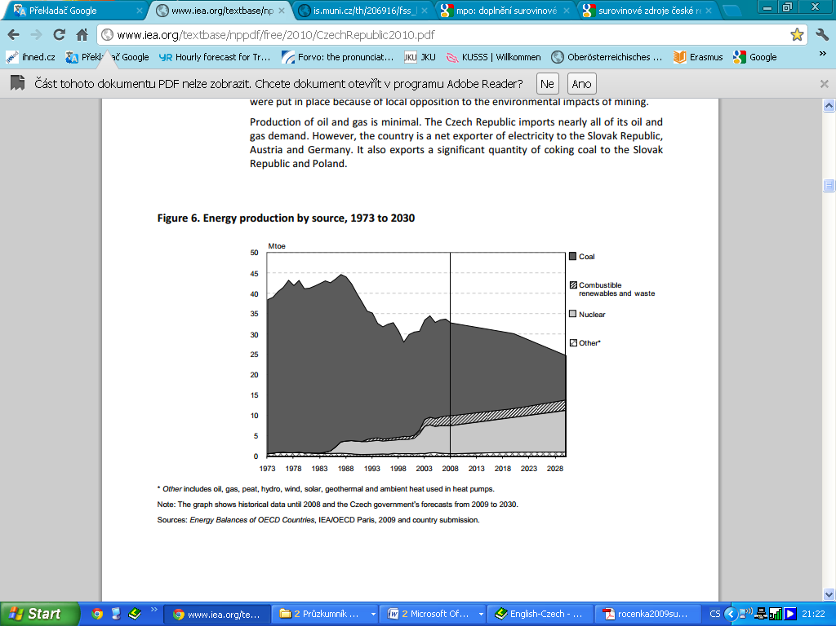
Current Situation
Energy-Independency as National Strategy
Total Production
  Czech Republic Austria
Source: (IEA, 2010b) Source: (IEA, 2008)

Slide 4
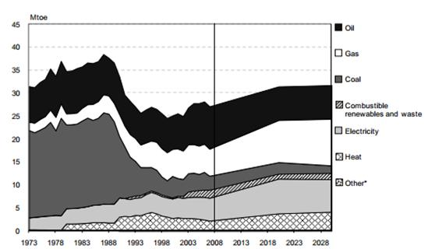
Current Situation
Energy-Independency as National Strategy
Total Production
Total Consumption
  Czech Republic Austria
Source: (IEA, 2010b) Source: (IEA, 2008)

Slide 5
Current Situation
Balance of trade in fuel-energy raw materials
Raw material |  | Black coal [kt] | Brown coal [kt] | Oil [kt] | Natural gas [TOE] | Uranium [t]
Czech Republic
 | Output/year | 11.435 | 43.774 | 272 | 167 | 322
 | Import/year | 3.170 | 207 | 10.454 | 6.976 | N/A
 | Export/year | 7.157 | 1.127 | 1.614 | 130 | 316
 | Gross domestic consumption | 8.142 | 43.807 | 9.162 | 8.019 | N/A
 | Gross domestic consumption [TJ] | 218.370 | 555.082 | 390.839 | 335.723 | 303.445
Home coverage |  | 140,4% | 99,9% | 3,0% | 2,1% | N/A
Austria
 | Output/year | - | 1 | 1.011 | 1.486 | -
 | Import/year | 4.390 | 53 | 13.621 | 10.192 | -
 | Export/year | 13 | 8 | 2.187 | 4.078 | -
 | Gross domestic consumption | 4.985 | 43 | 12.841 | 8.214 | -
 | Gross domestic consumption [TJ] | 141.505 | 717 | 548.075 | 343.922 | -
Home coverage |  | 0,0% | 2,3% | 7,9% | 18,1% | -
Source: (epp.eurostat.ec.europa.eu, 2012), (MŽP, 2009)

Slide 6
Current Situation
Imports and exports of Electricity
Source: (CSU, 2012) (Eurostat, 2012)

Slide 7
Current Situation
Imports and exports of Electricity
Source: (CSU, 2012) (Eurostat, 2012)

Slide 8
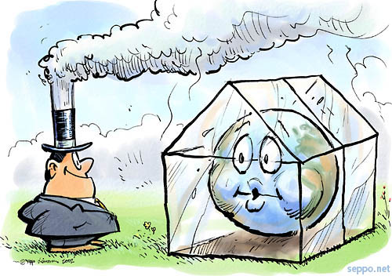
Ecological Aspects
Kyoto Agreement
  Reduction of greenhouse gas emissions
  Increasing of renewable energy
  Increasing of energy efficiency in Europe
Fossil fuels
Renewable energy
Nuclear energy

Slide 9
Ecological Aspects
Fossil Fuels
Renewable Energy
    Oil Calorific property and power
    Carbon dioxide => greenhouse effect
    Mining
    Accidents during transportation
Oil
Black X Brown Coal
Gas = the most environmentally friendly fossil fuel
    Reduction of emissions => mitigation of global warming
    Pumped storage plants are able to accumulate energy
    Low calorific property and power
    Occupation of fertile ground
    Wind power plants – noise
Solar, wind and hydro energy
Biomass

Slide 10
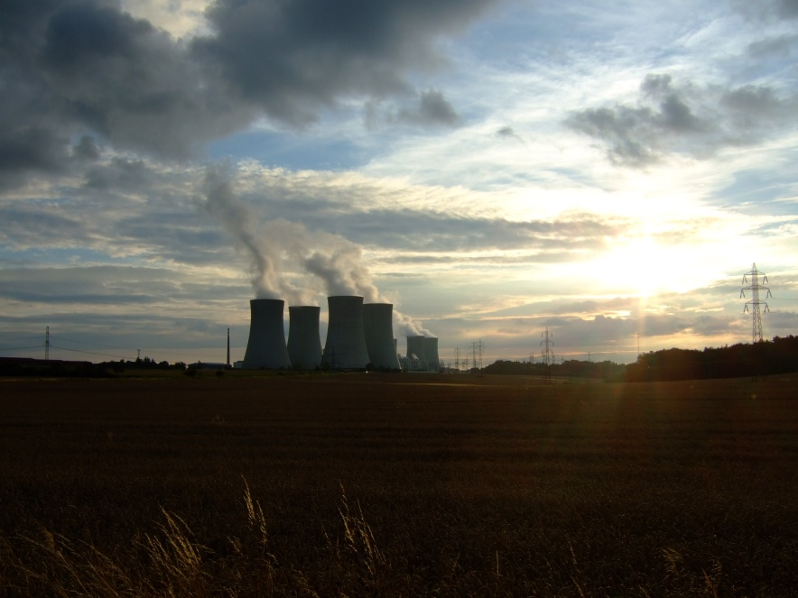
Ecological Aspects
Nuclear Energy
Possibility of nuclear accident – Chernobyl, Fukušima
Mining of uranium
Storage of spent fuel
Radioactivity
Does not produce carbon dioxide
Great performance on small area
Dukovany

Slide 11
Economic Aspects
Power plant production of electricity
Costs
  Capital, Operating, Fuel, External
Discount rate, Development of fuel prices
Total costs of current production
 | €/MWh | Coal | Natural gas | CHP* | Hydro | Geothermal | PV | Nuclear
CZ | min | 57 | 63 | 29 | 106 | 112 | 267 | 47
 | max | 104 | 80 | 272 | 312 | 184 | 416 | 78
AUT | min | 0 | 0 | 35 | 33 | 0 | 0 | 0
 | max | 0 | 0 | 38 | 63 | 0 | 0 | 0
Source: (IEA, 2010)

Slide 12
Economic Aspects
Power plant production of electricity
Costs
  Capital, Operating, Fuel, External
Discount rate, Development of fuel prices
Total costs of current production
Total costs of possible new production
€/MWh | Brown coal | Black coal | Natural gas | Biomass | Wind | PV | Nuclear
min | 49 | 56 | 73 | 107 | 102 | 228 | 41
max | 63 | 67 | 84 | 122 | 137 | 380 | 66
Source: (Wissel, 2010)

Slide 13


Suggestions
Nuclear energy = NO POSSIBILITY!!!
Using of good geographical location =>
  Pumped storage plants
  Combustible Renewable
  Wind
  Solar
  Photovoltaic
Substitute of coal power plants for more ecological source of energy:
  Renewable or
  Nuclear power = high-performing + environmentally friendly => solution

Slide 14
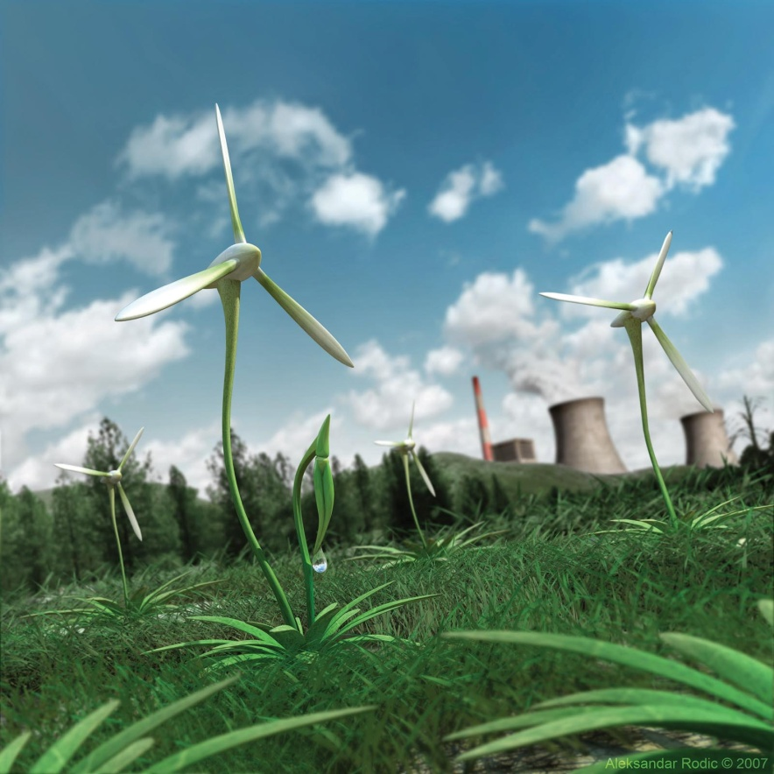
Conclusion
The main goal of both governments = reduce energy dependency
How to make the energy system more independent?
  Austria = RENEWABLE
  Czech Republic = NUCLEAR ENERGY

Slide 15

Thanks for your attention!

Slide 17
Appendix 1

Slide 18
Appendix 2

